Slide 1
SIKKIM WILDLIFE
BY harshit
kabilen
mazin
ashu
English project

Slide 2

Intoduction
The region of Sikkim is not only known for its pristine hilly beauty and mesmerizing landscape, but also for the richness of the varied wildlife. The Wildlife of Sikkim is pretty diverse than the other wildlife destinations in India due to the varied altitude of the region. The varying height of the landscape of Sikkim offers a variety of different flora and fauna in the various parts of this Himalayan state. From the tropical area to the Alpine area, the hilly terrain of Sikkim has the best and varied landscape and ecology which is the reason for the thriving wildlife. The wildlife sanctuaries and national parks in Sikkim are the best places to spend your holiday exploring the unique and rich wildlife. The flourishing dense forests of Sikkim make the perfect natural habitat for the varied wild animals and exotic birds of the hilly terrain of Sikkim. The various species of wild animals enriching the wildlife of Sikkim are the snow leopard, leopard, Himalayan bear, red panda, wild ass, musk deer and many others.

Slide 3
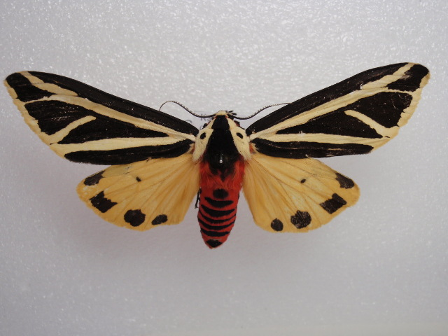
Areas imperialis
Areas imperialis is a moth of the family Erebidae. It was described by Vincenz Kollar in 1844. It is found in Tibet, the north-western Himalayas, Sikkim and Nepal
Kingdom: | Animalia
Phylum: | Arthropoda
Class: | Insecta
Order: | Lepidoptera
Superfamily: | Noctuoidea
Family: | Erebidae
Subfamily: | Arctiinae
Genus: | Areas
Species: | A. imperialis

Slide 4
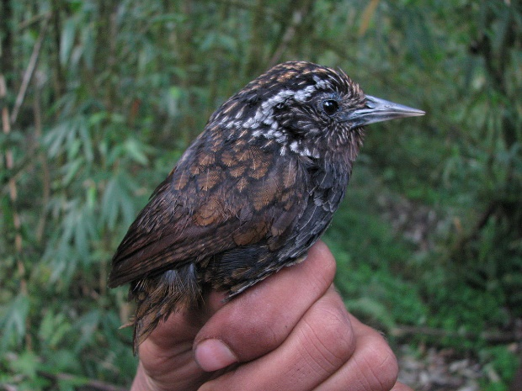
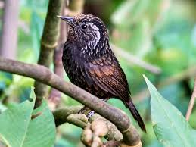
Sikkim wedge-billed babbler
The Sikkim wedge-billed babbler or blackish-breasted babbler (Stachyris humei) is a species of bird in the Old World babbler family (Timaliidae). It is named for the Indian state of Sikkim.
It inhabits the understorey of broadleaf evergreen forest and bamboo at 900–1,950 m, favouring westward facing slopes in Bhutan. It occupies lower elevations only during the winter. It occurs in small parties and feeds on insects, particularly woodlice and boring beetles.[

Slide 5
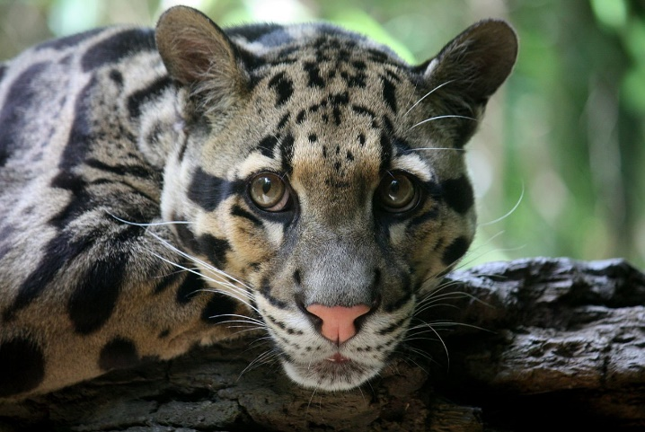
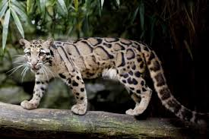
Clouded leopard
The clouded leopard (Neofelis nebulosa) is a medium-sized wild cat occurring from the Himalayan foothills through mainland Southeast Asia into southern China. Since 2008, it is listed as Vulnerable on the IUCN Red List. Its total population is suspected to be fewer than 10,000 mature individuals, the clouded leopard's fur is of a dark grey or ochreous ground-color, often largely obliterated by black and dark dusky-grey blotched pattern.
There are black spots on the head, and the ears are black. Partly fused or broken-up stripes run from the corner of the eyes over the cheek, from the corner of the mouth to the neck, and along the nape to the shoulders

Slide 6
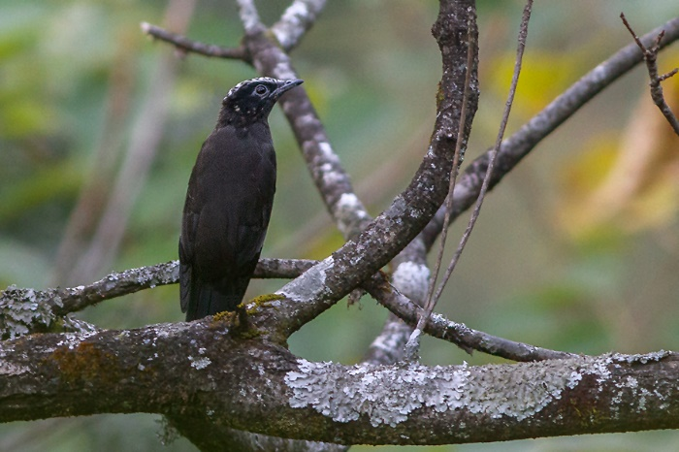
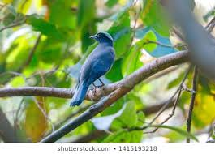
Purple cochoa
The purple cochoa (Cochoa purpurea) is a brightly coloured bird found in the temperate forests of Asia. It is a quiet and elusive bird species that has been considered to be related to the thrushes of family Turdidae or the related Muscicapidae (Old World flycatchers). They are found in dark forested areas and is found in the canopy, where it often sits motionless. his bird appears dark in the shade of the forest and the colours become clear only when it is lit by the sun.
The crown is silvery blue and a black mask runs over the eye. A grey carpal patch is present at the base of the black wing feathers and a wing patch is prominent. The tail is silvery blue with a black terminal band.

Slide 7
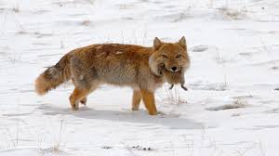
Tibetan fox
The Tibetan fox (Vulpes ferrilata), also known as Tibetan sand fox, is a species of true fox endemic to the high Tibetan Plateau, Ladakh plateau, Nepal, China, Sikkim, and Bhutan, up to altitudes of about 5,300 m (17,400 ft). It is listed as Least Concern in the IUCN Red List, on account of its widespread range in the Tibetan Plateau's steppes and semi-deserts.
The Tibetan fox is small and compact, with soft, dense coats and conspicuously narrow muzzles and bushy tails. Its muzzle, crown, neck, back and lower legs are tan to rufous coloured, while its cheeks, flanks, upper legs and rumps are grey. Its tail has white tips

Slide 8
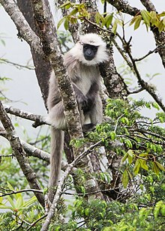
Nepal gray langur
The Nepal gray langur (Semnopithecus schistaceus) is a gray langur endemic to the Himalayas in Nepal, far southwestern Tibet, northern India, northern Pakistan, Bhutan and possibly Afghanistan. It is found in forests at an elevation of 1,500 to 4,000 metres (4,900 to 13,100 ft).^{[1]} Its easternmost limit in India is Buxa Tiger Reserve in northern West Bengal, at least up to the Rydak river.^{[3][4]}
The Nepal gray langur is both terrestrial and arboreal and eats leaves.^{[1]} At 26.5 kilograms (58 lb), the heaviest langur ever recorded was a male Nepal gray langur.^{[5]}

Slide 9
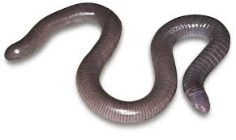
Caecilians
Caecilians (/sɪˈsɪliən/; New Latin for "blind ones") are a group of limbless, vermiform or serpentine amphibians. They mostly live hidden in the ground and in stream substrates, making them the least familiar order of amphibians. All modern caecilians and their closest fossil relatives are grouped as a clade, Apoda, within the larger group Gymnophiona, which also includes more primitive extinct caecilian-like amphibians.^{[1]} Caecilians are mostly distributed in the tropics of South and Central America, Africa, and southern Asia. Their diet consists of small subterranean creatures such as earthworms.

Slide 10
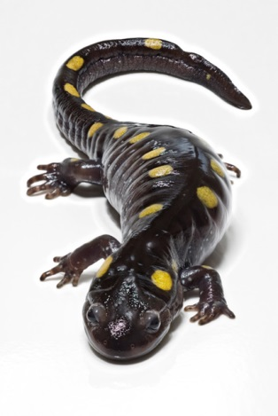
Salamanders
Salamanders are a group of amphibians typically characterized by a lizard-like appearance, with slender bodies, blunt snouts, short limbs projecting at right angles to the body, and the presence of a tail in both larvae and adults. All present-day salamander families are grouped together under the order Urodela. Salamander diversity is highest in the Northern Hemisphere and most species are found in the Holarctic realm, with some species present in the Neotropical realm.
Salamanders rarely have more than four toes on their front legs and five on their rear legs, but some species have fewer digits and others lack hind limbs. Their permeable skin usually makes them reliant on habitats in or near water or other cool, damp places

Slide 11

Frogs
Duttaphrynus himalayanus, also known as the Himalaya toad, Himalayan toad, Himalayan broad-skulled toad, and Günther's high altitude toad (among others), is a species of toad that is widely distributed throughout the Himalayan mountains. The Yunnanese populations are sometimes considered a separate species, Duttaphrynus cyphosus.^{[1][2]} The crown is deeply concave, with low, blunt supraorbital ridges. The snout is short and blunt, the interorbital space is broader than the upper eyelid, and the tympanum is very small and rather indistinct.

Slide 12
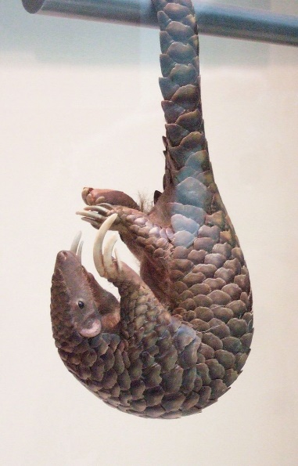
Chinese pangolin
The Chinese pangolin (Manis pentadactyla) is a pangolin native to the northern Indian subcontinent, northern parts of Southeast Asia and southern China. It has been listed as Critically Endangered on the IUCN Red List since 2014, as the wild population is estimated to have declined by more than 80% in three pangolin generations, equal to 21 years. It is threatened by poaching for the illegal wildlife trade.^{[1]} Habitats include
Primary and secondary tropical forests
Bamboo forests
Limestone forests
Broadleaf forests
Coniferous forests
Agricultural fields
Grasslands

Slide 13
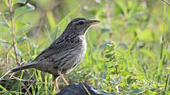
Upland pipit
The upland pipit (Anthus sylvanus) is a species of bird in the family Motacillidae. It is found in Afghanistan, China, Hong Kong, India, Sikkim,Nepal, and Pakistan

Slide 14
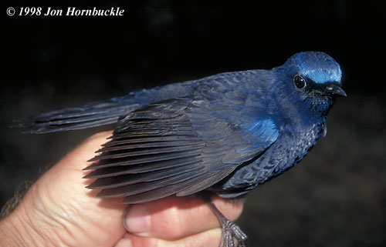
Blue-fronted robin
The blue-fronted robin (Cinclidium frontale) is a species of bird in the family Muscicapidae. It is the only species in the monotypic genus Cinclidium.^{[2]} It is found in Bhutan, China, Northeast India, Laos, Thailand, Vietnam, and possibly Nepal. Its natural habitat is temperate forests.^{[1]}

Slide 15
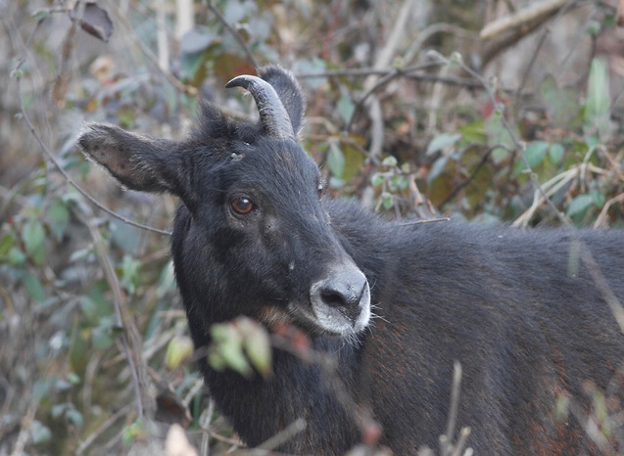
Himalayan serow
The Himalayan serow (Capricornis sumatraensis thar) is native to the Himalayas.^{[1]} Since 2019, it is recognised as a subspecies of the mainland serow.^{[2]}

Slide 16
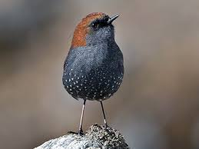
Gould's shortwing
Gould's shortwing (Heteroxenicus stellatus) is a small species of passerine bird in the family Muscicapidae. It is found in the Himalayas (mainly Uttarakhand, Sikkim and Bhutan), Yunnan and northern parts of Myanmar and Vietnam. It breeds in the eastern Himalayas in rocky areas above the tree-line and winters at lower altitude in wooded valleys.
Gould's shortwing is the only species in the genus Heteroxenicus. It was formerly placed in the genus Brachypteryx.
The common name commemorates the English ornithologist and bird artist John Gould
Gould's shortwing is 12–13 cm (4.7–5.1 in) in length with a weight of 19–23 g (0.67–0.81 oz). It is chestnut coloured above and dark grey below with small white spots or stars on its belly. It has long brown legs and a black bill. The sexes are similar. Nothing is known about the nest or the eggs

Slide 17
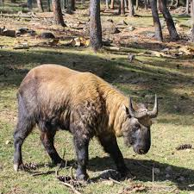
Bhutan takin
The Bhutan takin (Budorcas taxicolor whitei) is a vulnerable subspecies of Takin native to Bhutan, North Eastern India, Western part of China, and Tibet. The main threats to the Bhutan Takin are hunting and habitat loss.[ In Bhutan, Takin are found in bamboo forests at altitudes of 1,000 to 4,500 metres (3,300 to 15,000 ft), where they eat grass, buds and leaves. Takins are diurnal, active in the day, resting in the heat on particularly sunny days. Takin gather in small herds in winter and herds of up to a hundred individuals in the summer; in winter, they move to lower elevations and split into smaller herds of 10-50 individuals, mostly in the Gasa District. As is often seen in bison, old males are often solitary.

Slide 18
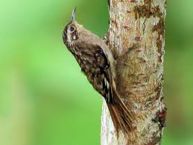
Sikkim treecreeper
The Sikkim treecreeper (Certhia discolor) is a species of bird in the treecreeper family.
It is found in Bhutan, Nepal and Northeast India.^{[citation needed]}
Its natural habitats are temperate forests and subtropical or tropical moist montane forests.^{[citation needed]}
The form C. d. manipurensis of southern Manipur and southwestern Burma has a rich cinnamon throat and breast, and molecular evidence and is usually now treated as a separate species, the Hume's treecreeper, C. manipurensis Hume, 1850.^{[2]}

Slide 19
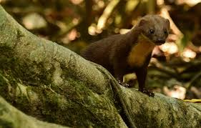
Back-striped weasel
. The back-striped weasel (Mustela strigidorsa), also called the stripe-backed weasel, is a weasel widely distributed in Southeastern Asia. It is listed as Least Concern on the IUCN Red List in view of its presumed large population, occurrence in many protected areas, apparent t olerance to some degree of habitat modification and hunting pressure.

Slide 20
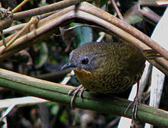
Rufous-throated wren-babbler
The rufous-throated wren-babbler (Spelaeornis caudatus) is a species of bird in the family Timaliidae. It is found in Bhutan, India, and Nepal.
Its natural habitat is the Eastern Himalayan broadleaf forests. It is becoming rare due to habitat loss.

